Slide 1

Global Terrorism
A model to predict the group associated with an act of terror
Team 2-08
Jenna Andino | Caleb Connerty | Jessie Gong | Michael McKenna

Slide 2

INTRODUCTION
Agenda
THE PROBLEM
DATA PREPARATION
MODEL BUILDING
THE RESULTS
An overview of the problem our model will attempt to solve
Where we found reliable data and how we prepped it
How we developed our model and challenges we faced along the way
An assessment of the model’s accuracy and overall success
1

Slide 3

INTRODUCTION
Who We Are
We represent the U.S. Department of Homeland Security (DHS)
Our Vital Mission
To secure the nation from the many threats we face

Slide 4
THE PROBLEM

Slide 5

THE PROBLEM
Global Terrorism
Since 2000, terrorism has claimed the lives of 140,000 people across the globe
US spending on counter-terrorism efforts is nearly $100 billion per year
When an attack occurs, identifying the group tied to it is one of DHS’s main responsibilities
4

Slide 6



THE PROBLEM
Who Is Responsible?
From ‘06 – ‘16, 29.28% of global terrorist attacks have been tied to ISIL or the Taliban
We’ve developed a model to predict if ISIL or the Taliban are responsible for an act of terror
Narrowing down the responsible party to 1 of 2 groups will allow the US to retaliate appropriately
5

Slide 7
DATA PREPARATION

Slide 8



DATA PREPARATION
The Global Terrorism Database
THE GLOBAL TERRORISM DATABASE (GTB)
An open-source database developed to be a comprehensive, methodologically robust set of data on domestic and international terrorism
DATA CHARACTERISTICS
Made available by START – The National Consortium for the Study of Terrorism and Response to Terrorism
Currently the most comprehensive, unclassified database on terrorist events in the world
TIMEFRAME
Contains data from 1975 – 2016 | Our model utilizes data from 2006 – 2016
7

Slide 9

DATA PREPARATION
Cleaning The Data
COLUMNS
Eliminated any columns (exception - Group Name) with 5%+ of the rows containing blank values
ROWS
Deleted any rows with null values to naturally create a random sample
90
21
40K
35K
FINAL DATA
After cleaning our data, we were left with 35,392 rows (data points) and 21 columns (inputs) to develop our model
10,364 data points were associated with either the Taliban or ISIL
8

Slide 10
MODEL BUILDING

Slide 11

MODEL BUILDING
Objectives
CORRECTNESS
TYPE 1 ERROR
TYPE 2 ERROR
GOAL
GOAL
GOAL
To maximize the percentage of times the model will produce an overall correct result
To minimize when the model says the Taliban / ISIL was responsible when they were not
To minimize when the model says that the Taliban / ISIL was not responsible when they were
ERROR PRIORITY
We developed our model to prioritize minimizing Type 2 Error
10

Slide 12
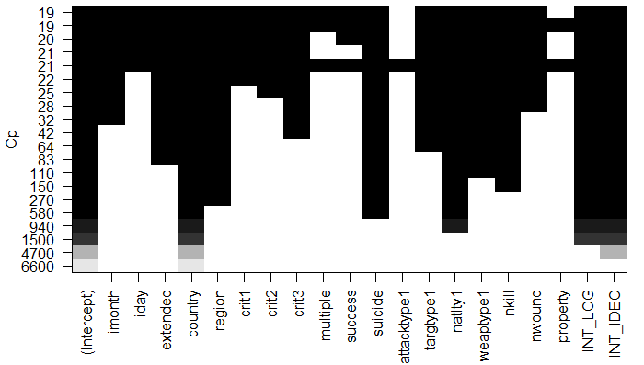
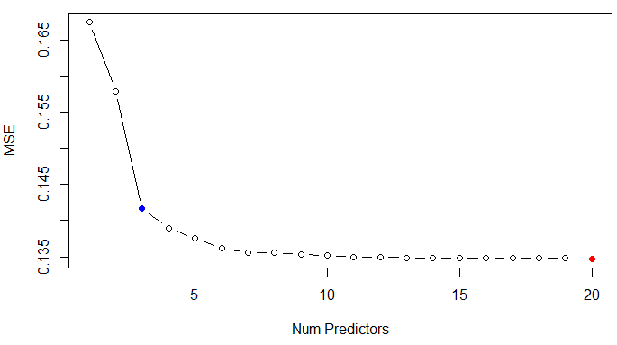
MODEL BUILDING
Best Subset Selection
Regular | Exhaustive
VALIDATION SET
First, we performed regular exhaustive best subset selection to identify the variables relevant to our analysis
Added variables remained
VALIDATION MSEs
3 variables appeared to be most predictive:
Country – the country the incident occurred in
INT_LOG – comparison between the nationality of the perpetrator group and the location of the attack
INT_IDEO – indicates whether a perpetrator group attacks a target of a different nationality
11

Slide 13
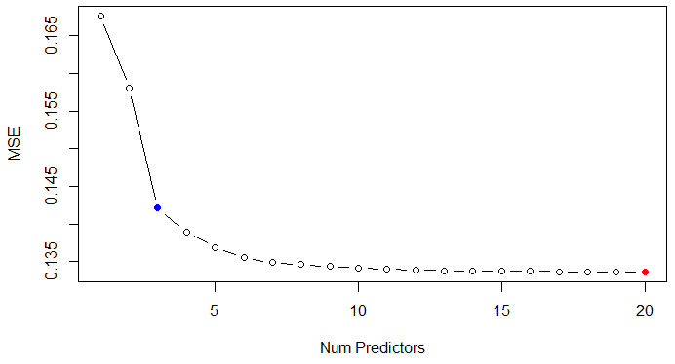
MODEL BUILDING
Best Subset Selection
K-fold = 10 | Exhaustive
To ensure our results were not random, we performed a KNN exhaustive best subset selection
CROSS VALIDATION MSEs
K = 10
The results were the same as regular subset selection
12

Slide 14
MODEL BUILDING
Our Approach
For thoroughness, we tested three model under 5 different variable selection methods
Model | Subset
LogR | 3
LDA | 3
QDA | 3
LogR | 4
LDA | 4
QDA | 4
LogR | 5
LDA | 5
QDA | 5
LogR | Lasso
LDA | Lasso
QDA | Lasso
LogR | PCR
The Models
Logistic Regression
LDA
QDA
The Variable Selection Methods
Exhaustive → 3
Exhaustive → 4
Exhaustive → 5
Lasso
PCR
13

Slide 15
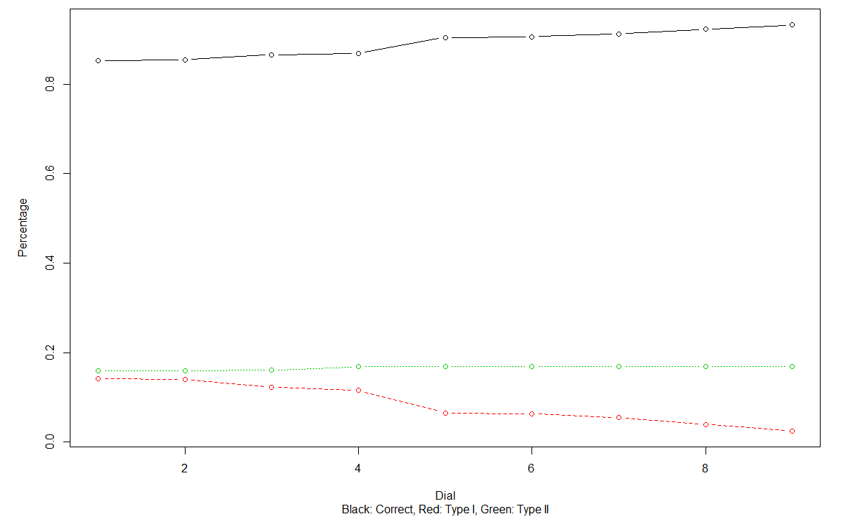
MODEL BUILDING
Logistic Regression
Exhaustive | 3 Variables
Variables
Country, INT_LOG, INT_IDEO
IMPACT OF DIFFERENT DIAL SETTINGS ON
LOGISTIC REGRESSION PREDICTION
Dial
c(0.3, 0.35, 0.40, 0.45, 0.5, 0.55, 0.6, 0.65, 0.7)
Results
CORRECTNESS
TYPE 1 ERROR
TYPE 2 ERROR
85.25%
14.26%
15.93%
14

Slide 16
MODEL BUILDING
LDA & QDA
Exhaustive | 3 Variables
LDA
QDA
Variables
Country, INT_LOG, INT_IDEO
Variables
Country, INT_LOG, INT_IDEO
Results
Results
CORRECTNESS
TYPE 1 ERROR
TYPE 2 ERROR
CORRECTNESS
TYPE 1 ERROR
TYPE 2 ERROR
91.60%
5.20%
16.12%
67.90%
39.93%
13.19%
15

Slide 17
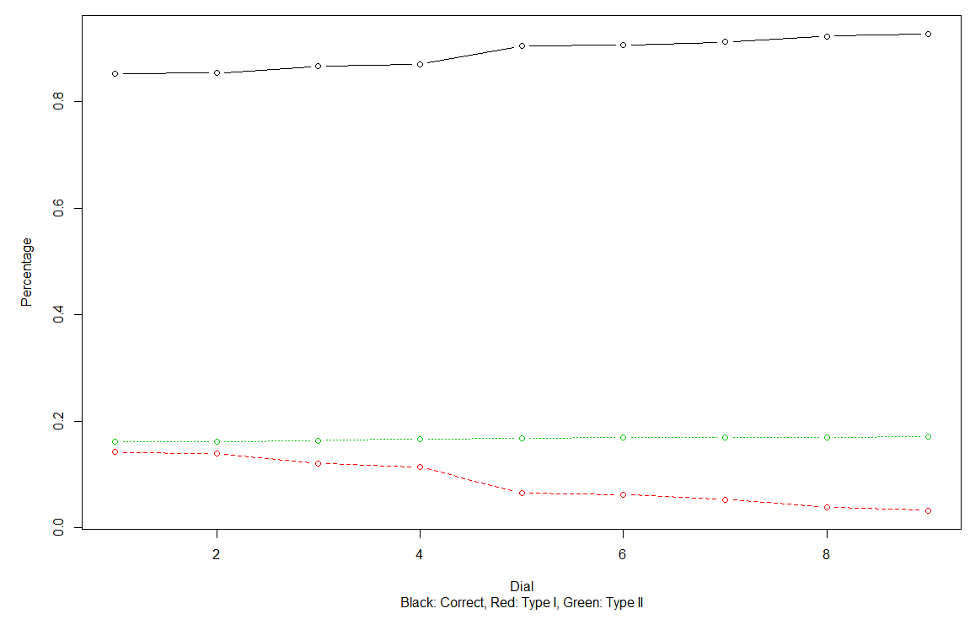
MODEL BUILDING
Logistic Regression
Exhaustive | 4 Variables
Variables
Country, INT_LOG, INT_IDEO, natlty1
IMPACT OF DIFFERENT DIAL SETTINGS ON
LOGISTIC REGRESSION PREDICTION
Dial
c(0.3, 0.35, 0.40, 0.45, 0.5, 0.55, 0.6, 0.65, 0.7)
Results
CORRECTNESS
TYPE 1 ERROR
TYPE 2 ERROR
85.19%
14.23%
16.21%
16

Slide 18
MODEL BUILDING
LDA & QDA
Exhaustive | 4 Variables
LDA
QDA
Variables
Country, INT_LOG, INT_IDEO, natlty1
Variables
Country, INT_LOG, INT_IDEO, natlty1
Results
Results
CORRECTNESS
TYPE 1 ERROR
TYPE 2 ERROR
CORRECTNESS
TYPE 1 ERROR
TYPE 2 ERROR
90.61%
6.48%
16.43%
70.58%
36.17%
13.15%
17

Slide 19
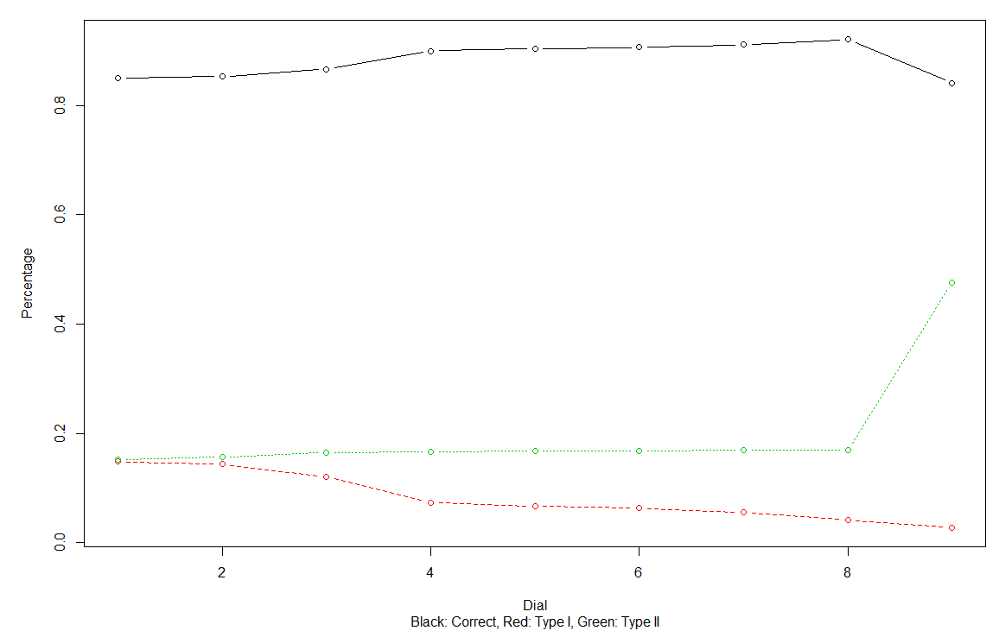
MODEL BUILDING
Logistic Regression
Exhaustive | 5 Variables
Variables
Country, INT_LOG, INT_IDEO, natlty1, suicide
IMPACT OF DIFFERENT DIAL SETTINGS ON
LOGISTIC REGRESSION PREDICTION
Dial
c(0.3, 0.35, 0.40, 0.45, 0.5, 0.55, 0.6, 0.65, 0.7)
Results
CORRECTNESS
TYPE 1 ERROR
TYPE 2 ERROR
85.05%
14.84%
15.24%
18

Slide 20
MODEL BUILDING
LDA & QDA
Exhaustive | 5 Variables
LDA
QDA
Variables
Country, INT_LOG, INT_IDEO, natlty1, suicide
Variables
Country, INT_LOG, INT_IDEO, natlty1, suicide
Results
Results
CORRECTNESS
TYPE 1 ERROR
TYPE 2 ERROR
CORRECTNESS
TYPE 1 ERROR
TYPE 2 ERROR
91.52%
5.53%
15.57%
82.85%
19.51%
11.45%
19

Slide 21
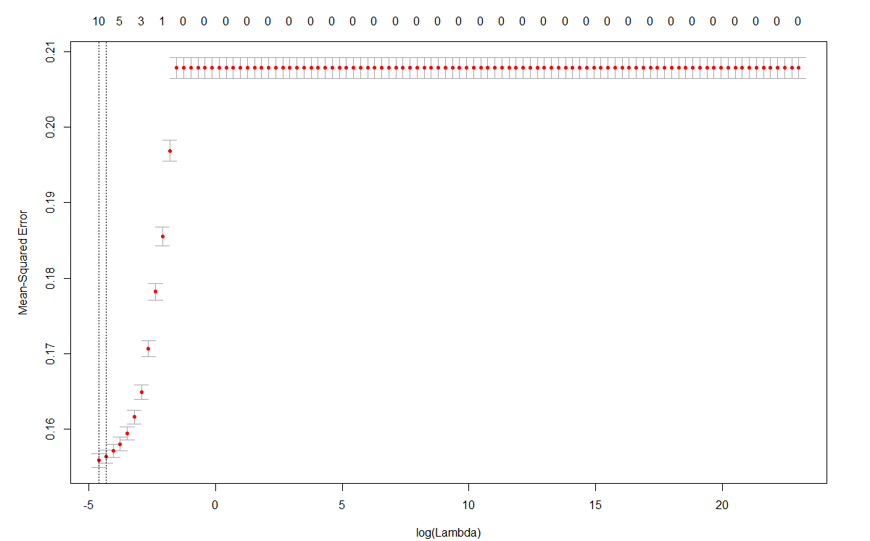
MODEL BUILDING
Variable Selection
Lasso
Lasso identified 6 variables to use within our models:
Extended – duration of incident lasted more than 24 hours
Country – the country the incident occurred in
Region – the region the incident occurred in
Multiple – connected to additional attacks
Suicide – the incident was a suicide attack
Target Type 2 – armed assault
LASSO CROSS VALIDATION
20

Slide 22
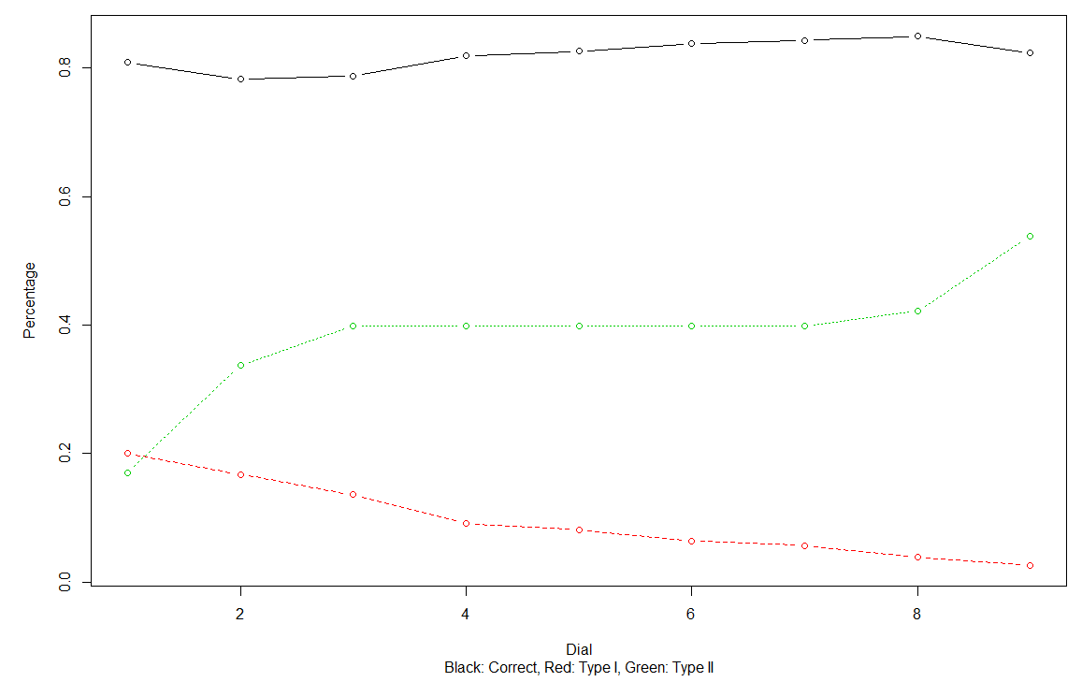
MODEL BUILDING
Logistic Regression
Lasso
Variables
Extended, Country, Region, Multiple, Suicide, Target Type 2
IMPACT OF DIFFERENT DIAL SETTINGS ON
LOGISTIC REGRESSION PREDICTION
Dial
c(0.3, 0.35, 0.40, 0.45, 0.5, 0.55, 0.6, 0.65, 0.7)
Results
CORRECTNESS
TYPE 1 ERROR
TYPE 2 ERROR
80.89%
20.00%
16.96%
21

Slide 23
MODEL BUILDING
LDA & QDA
Lasso
LDA
QDA
Variables
Extended, Country, Region, Multiple, Suicide, Target Type 2
Variables
Extended, Country, Region, Multiple, Suicide, Target Type 2
Results
Results
CORRECTNESS
TYPE 1 ERROR
TYPE 2 ERROR
CORRECTNESS
TYPE 1 ERROR
TYPE 2 ERROR
84.90%
4.89%
39.79%
81.23%
5.69%
50.31%
22

Slide 24
MODEL BUILDING
Subset Selection
PCR
VARIABLES
PRO
CON
Undistinguishable
If results are sound, provides a quick, accurate result
Impact of individual factors cannot be analyzed
23

Slide 25
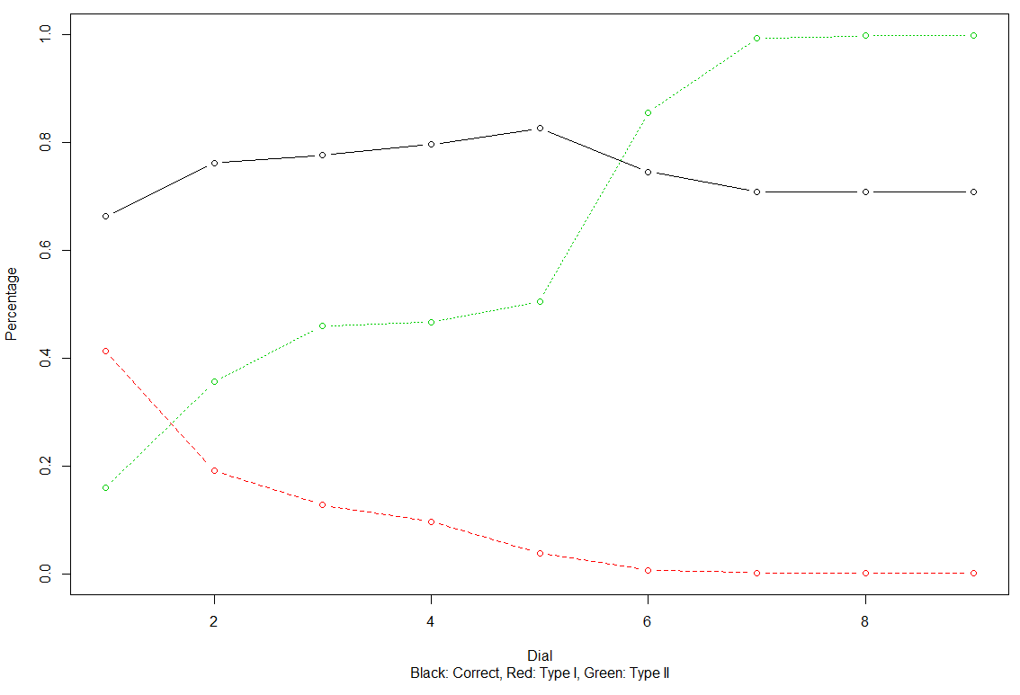
MODEL BUILDING
Logistic Regression
PCR
Variables
Unknown
IMPACT OF DIFFERENT DIAL SETTINGS ON
LOGISTIC REGRESSION PREDICTION
Dial
c(0.30, 0.35, 0.40, 0.45 ,0.50, 0.55, 0.60, 0.65, 0.70)
Results
CORRECTNESS
TYPE 1 ERROR
TYPE 2 ERROR
66.18%
41.21%
15.95%
24

Slide 26
THE RESULTS

Slide 27
THE RESULTS
Summary
Model | Subset | Overall Correctness | Type 1 Error | Type 2 Error | Power
LogR | 3 | 85.25% | 14.26% | 15.93% | 0.84
LDA | 3 | 91.60% | 5.20% | 16.12% | 0.84
QDA | 3 | 67.90% | 39.93% | 13.94% | 0.86
LogR | 4 | 85.19% | 14.23% | 16.22% | 0.84
LDA | 4 | 90.61% | 6.48% | 16.43% | 0.84
QDA | 4 | 70.58% | 36.17% | 13.15% | 0.87
LogR | 5 | 85.05% | 14.84% | 15.24% | 0.85
LDA | 5 | 91.52% | 5.54% | 15.57% | 0.84
QDA | 5 | 82.85% | 19.51% | 11.45% | 0.86
LogR | Lasso | 80.89% | 20.00% | 16.96% | 0.83
LDA | Lasso | 84.89% | 4.89% | 39.79% | 0.60
QDA | Lasso | 81.23% | 5.69% | 50.31% | 0.50
LogR | PCR | 66.18% | 41.21% | 15.95% | 0.84
26

Slide 28
THE RESULTS
TBD
Top model / subset
Next steps
27

Slide 29
THE RESULTS
TBD
Summary
28

